Slide 1

The Swift Programming Language
Course: Fundamentals of Programming languages
Lecturer: Ariel Stulman
Student: ELIE drai

Slide 2
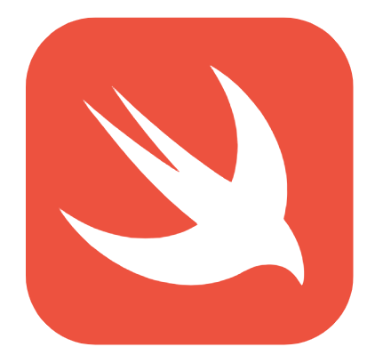
Overview
1) History
2) Goals and motivation
3) CHARACTERISTICS
4) CONCLUSION

Slide 3

History
Development of Swift started in July 2010 by Chris Lattner, with the collaboration of other programmers from Apple.
Swift took language ideas from Objective-C, Rust, Haskell, Ruby, Python, C#...
On September 9th 2014, the first version of Swift was available (Swift 1.0)
…
Actual version of Swift is 4.1, available since March 29th, 2018

